Slide 1
Data Link Layer

Slide 2
Responsibilities
Framing
The stream of bits received from the network layer is divided into manageable data units called frames.
Addressing
A header is added to the frame to define the addresses of the sender and receiver of the frame.
Flow control
If the data absorption rate at the receiver is less than the data production rate in the sender, a flow control mechanism is imposed to avoid overwhelming the receiver.

Slide 3
Responsibilities
Error control
The data link layer also adds reliability to the physical layer by adding mechanisms to detect and retransmit damaged, duplicate, or lost frames.
Media access control
When two or more devices are connected to the same link, data link layer protocols are necessary to determine which device has control over the link at any given time.

Slide 4
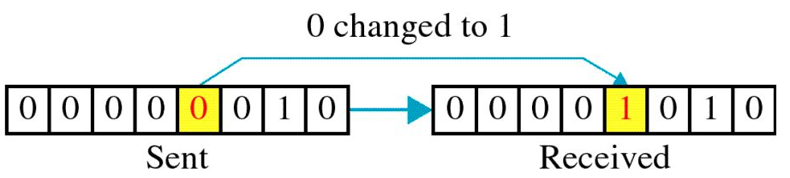
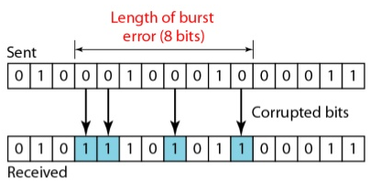
Error Detection and Correction
Types of Errors
Single-Bit Error
Burst Error
To detect or correct errors, we need to send extra (redundant) bits with data.

Slide 5
Detection Versus Correction
Correction of errors is more difficult than the detection.
In error detection, we are looking only to see if any error has occurred. The answer is a simple yes or no. We are not even interested in the number of errors.
A single-bit error is the same for us as a burst error.
In error correction, we need to know the exact number of bits that are corrupted and more importantly, their location in the message.
The number of the errors and the size of the message are important factors.
If we need to correct one single error in an 8-bit data unit, we need to consider eight possible error locations; if we need to correct two errors in a data unit of the same size, we need to consider 28 possibilities. You can imagine the receiver's difficulty in finding 10 errors in a data unit of 1000 bits

Slide 6
Forward Error Correction Versus Retransmission
There are two main methods of error correction.
Forward error correction
Process in which the receiver tries to guess the message by using redundant bits.
This is possible if the number of errors is small.
Retransmission
Technique in which the receiver detects the occurrence of an error and asks the sender to resend the message.
Resending is repeated until a message arrives that the receiver believes is error-free (usually, not all errors can be detected).

Slide 7
Coding
Redundancy is achieved through various coding schemes.
The sender adds redundant bits through a process that creates a relationship between the redundant bits and the actual data bits.
The receiver checks the relationships between the two sets of bits to detect or correct the errors.
The ratio of redundant bits to the data bits and the robustness of the process are important factors in any coding scheme.
We can divide coding schemes into two broad categories:
block coding and
convolution coding (not in scope of the syllabus)

Slide 8
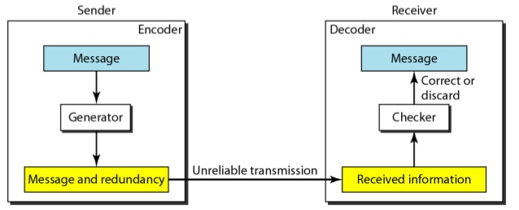
Structure of encoder and decoder

Slide 9
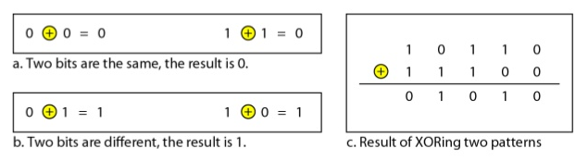
Modular Arithmetic
Modulo-2 Arithmetic

Slide 10
Block Coding
In block coding, messages are divided into k bits blocks, called datawords.
r redundant bits are added to each block to make the length n = k + r.
The resulting n-bit blocks are called codewords.
With k bits, a combination of 2^{k} datawords can be created; with n bits, a combination of 2^{n} codewords can be created.
Since n > k, the number of possible codewords is larger than the number of possible datawords.
The block coding process is one-to-one; the same dataword is always encoded as the same codeword, i.e., we have 2^{n} - 2^{k} unused codewords.

Slide 11
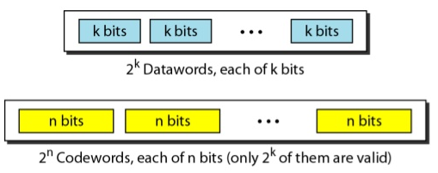
Block Coding

Slide 12
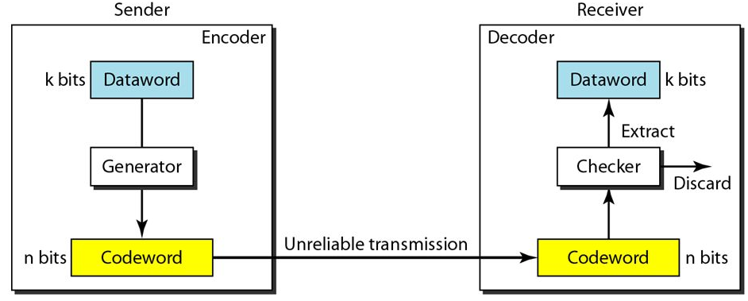
Error Detection
If the following two conditions are met, the receiver can detect a change in the original codeword.
The receiver has (or can find) a list of valid codewords.
The original codeword has changed to an invalid one.

Slide 13
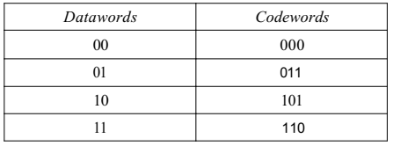
Let us assume that k =2 and n = 3

Slide 14
Assume the sender encodes the dataword 01 as 011 and sends it to the receiver.
Consider the following cases:
The receiver receives O11. It is a valid codeword. The receiver extracts the dataword 01 from it.
The codeword is corrupted during transmission, and 111 is received (the leftmost bit is corrupted). This is not a valid codeword and is discarded.
The codeword is corrupted during transmission, and 000 is received (the right two bits are corrupted). This is a valid codeword. The receiver incorrectly extracts the dataword 00. Two corrupted bits have made the error undetectable.

Slide 15
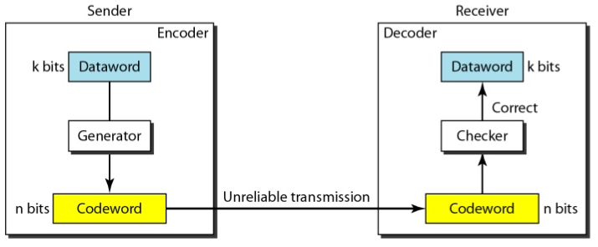
Error Correction
We need more redundant bits for error correction than for error detection

Slide 16
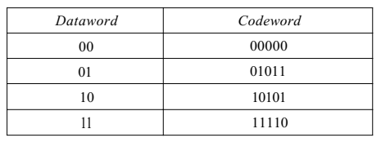
Let us add more redundant bits to the previous example to see if the receiver can correct an error without knowing what was actually sent.
We add 3 redundant bits to the 2-bit dataword to make 5-bit codewords.

Slide 17
The dataword is 01. The sender consults the table to create the codeword 01011.
The codeword is corrupted during transmission, and 01001 is received.
First, the receiver finds that the received codeword is not in the table.
This means an error has occurred. (Detection must come before correction.)
The receiver, assuming that there is only 1 bit corrupted, uses a strategy to guess the correct dataword.

Slide 18
Strategy
Comparing the received codeword with the first codeword in the table (01001 versus 00000), the receiver decides that the first codeword is not the one that was sent because there are two different bits.
By the same reasoning, the original codeword cannot be the third or fourth one in the table.
The original codeword must be the second one in the table because this is the only one that differs from the received codeword by 1 bit.
The receiver replaces 01001 with 01011 and consults the table to find the dataword 01

Slide 19
Hamming Distance
The Hamming distance between two words (of the same size) is the number of differences between the corresponding bits.
Hamming distance between two words x and y is represented as d(x, y).
The Hamming distance can easily be found if we apply the XOR operation on the two words and count the number of 1s in the result.
Note that the Hamming distance is a value greater than zero.
The Hamming distance d(000, 011) is 2 because 000 XOR 011 is 011 (two 1s).
The Hamming distance d(10101, 11110) is 3 because 10101 XOR 11110 is 01011 (three 1s).

Slide 20
Minimum Hamming Distance
Although the concept of the Hamming distance is the central point in dealing with error detection and correction codes, the measurement that is used for designing a code is the minimum Hamming distance.
In a set of words, the minimum Hamming distance is the smallest Hamming distance between all possible pairs.
We use d_{min} to define the minimum Hamming distance in a coding scheme.
To find this value, we find the Hamming distances between all words and select the smallest one.

Slide 21
Find the minimum Hamming distance of the coding scheme
d(000,011) = 2 d(000,101) = 2 d(000,110) = 2
d(011,101) = 2 d(011,110) = 2 d(101,110) = 2
d_{min} = 2
Any coding scheme needs to have at least three parameters: the codeword size n, the dataword size k, and the minimum Hamming distance d_{min}.
A coding scheme C is written as C(n, k) with a separate expression for d_{min}.

Slide 22
Hamming Distance and Error
When a codeword is corrupted during transmission, the Hamming distance between the sent and received codewords is the number of bits affected by the error.
In other words, the Hamming distance between the received codeword and the sent codeword is the number of bits that are corrupted during transmission.
For example, if the codeword 00000 is sent and 01101 is received, 3 bits are in error and the Hamming distance between the two is d(00000, 01101) =3.

Slide 23
Minimum Distance for Detection upto sbit Errors
If s errors occur during transmission, the Hamming distance between the sent codeword and received codeword is s.
If our code is to detect up to s errors, the minimum distance between the valid codes must be s + 1, so that the received codeword does not match a valid codeword.
The distances are not enough (s + 1) for the receiver to accept it as valid.
The error will be detected.
We need to clarify a point here: Although a code with d_{min} =s + 1 may be able to detect more than s errors in some special cases, only s or fewer errors are guaranteed to be detected.

Slide 24
Minimum Distance for Detection upto sbit Errors
The minimum Hamming distance for our first code scheme is 2. This code guarantees detection of only a single error.
For example, if the third codeword (101) is sent and one error occurs, the received codeword does not match any valid codeword.
If two errors occur, however, the received codeword may match a valid codeword and the errors are not detected.

Slide 25
Minimum Distance for Detection upto sbit Errors
Our second block code scheme has d_{min} = 3.
This code can detect up to two errors.
Again, we see that when any of the valid codewords is sent, two errors create a codeword which is not in the table of valid codewords.
The receiver cannot be fooled.
However, some combinations of three errors change a valid codeword to another valid codeword.
The receiver accepts the received codeword and the errors are undetected.

Slide 26
Minimum Distance for Error Correction
When a received codeword is not a valid codeword, the receiver needs to decide which valid codeword was actually sent.
To guarantee correction of up to t errors in all cases, the minimum Hamming distance in a block code must be d_{min} = 2t + 1.

Slide 27
A code scheme has a Hamming distance d_{min} = 4. What is the error detection and correction capability of this scheme?
This code guarantees the detection of up to three errors (s = 3), but it can correct up to one error.
In other words, if this code is used for error correction, part of its capability is wasted. Error correction codes need to have an odd minimum distance (3, 5, 7, ... ).

Slide 28
Linear Block Codes
A linear block code is a code in which the exclusive OR (addition modulo-2) of two valid code words creates another valid codeword.
A simple parity-check code is a single-bit error-detecting code in which n = k + 1 with d_{min} = 2.

Slide 29
Table 10.3 Simple parity-check code C(5, 4)

Slide 30
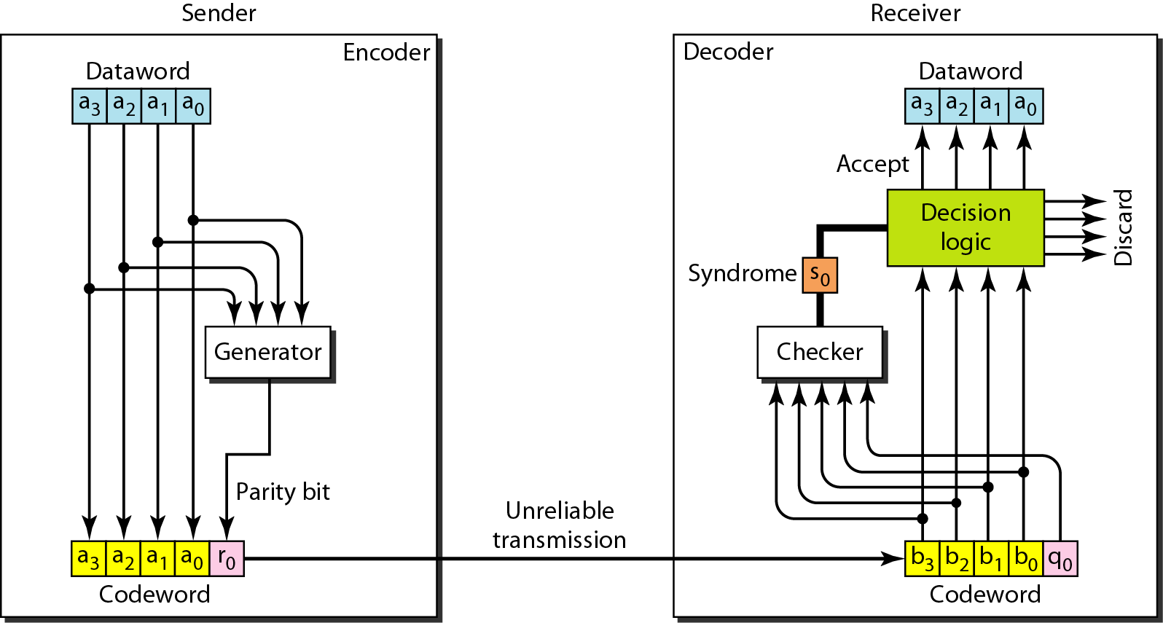
Figure 10.10 Encoder and decoder for simple parity-check code

Slide 31
Example 10.12
Let us look at some transmission scenarios. Assume the sender sends the dataword 1011. The codeword created from this dataword is 10111, which is sent to the receiver. We examine five cases:
1. No error occurs; the received codeword is 10111. The syndrome is 0. The dataword 1011 is created.
2. One single-bit error changes a₁ . The received codeword is 10011. The syndrome is 1. No dataword is created.
3. One single-bit error changes r₀ . The received codeword is 10110. The syndrome is 1. No dataword is created.

Slide 32
Example 10.12 (continued)
4. An error changes r₀ and a second error changes a₃ .
The received codeword is 00110. The syndrome is 0. The dataword 0011 is created at the receiver. Note that
here the dataword is wrongly created due to the
syndrome value.
5. Three bits—a₃, a₂, and a₁—are changed by errors. The received codeword is 01011. The syndrome is 1. The dataword is not created. This shows that the simple parity check, guaranteed to detect one single error, can also find any odd number of errors.

Slide 33
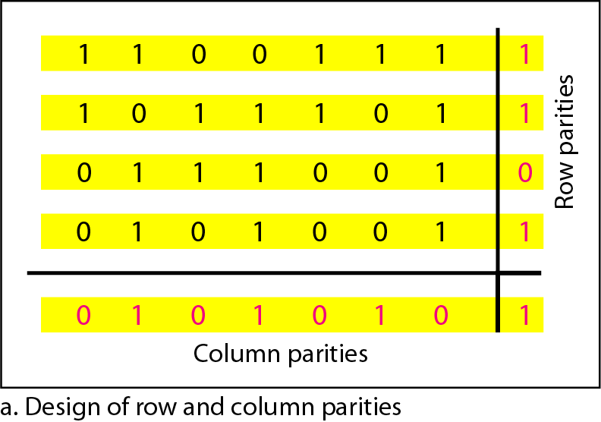
Figure 10.11 Two-dimensional parity-check code

Slide 34
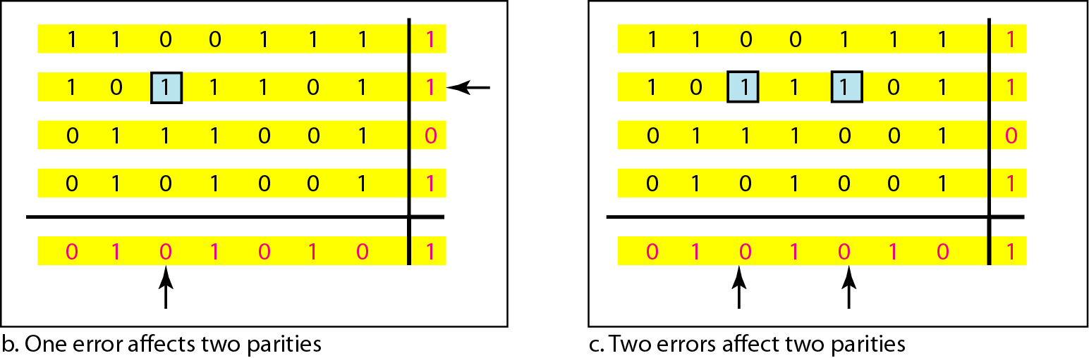
Figure 10.11 Two-dimensional parity-check code

Slide 35
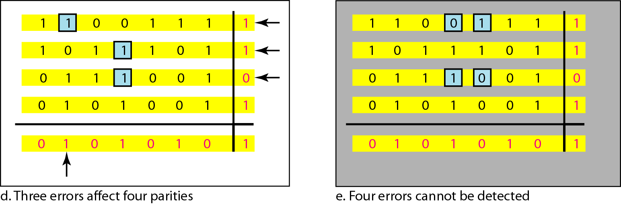
Figure 10.11 Two-dimensional parity-check code

Slide 36
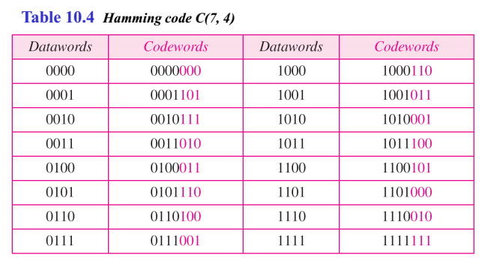

Slide 37
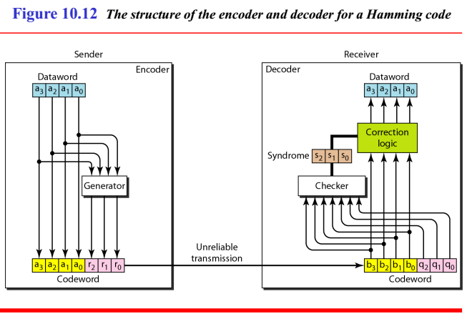
r₀=a₂+a₁+a₀
r₁=a₃+a₂+a₁
r₂=a₁+a₀+a₃
s₀=b₂+b₁+b₀+q₀
s₁=b₃+b₂+b₁+q₁
s₂=b₁+b₀+b₃+q₂

Slide 38
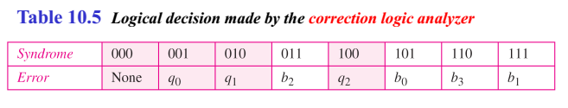

Slide 39
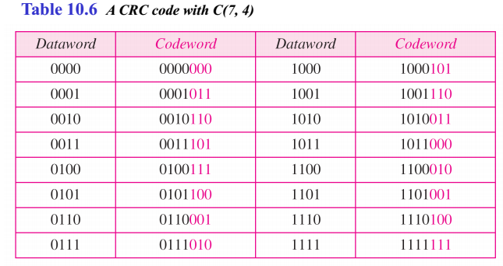
CYCLIC CODES
Cyclic codes are special linear block codes with one extra property. In a cyclic code, if a codeword is cyclically shifted (rotated), the result is another codeword.

Slide 40
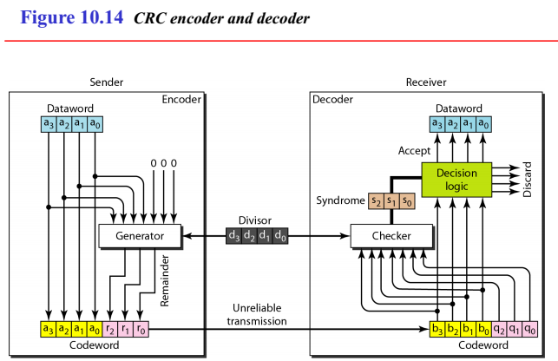

Slide 41
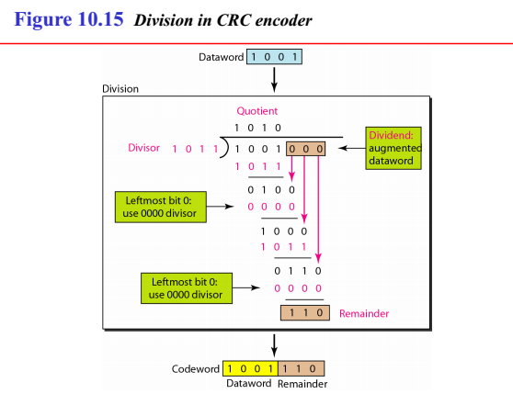

Slide 42
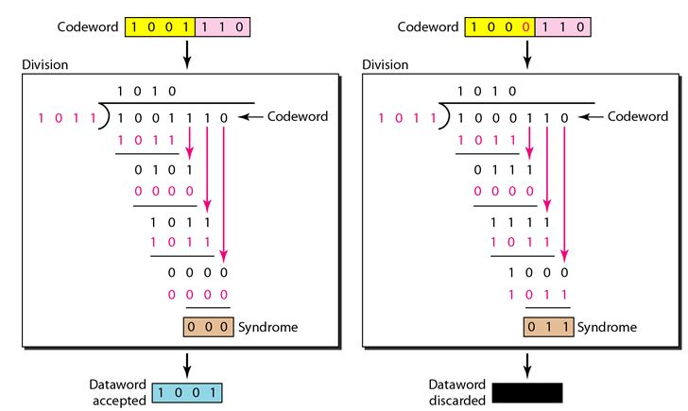
Division in CRC decoder for two cases

Slide 43
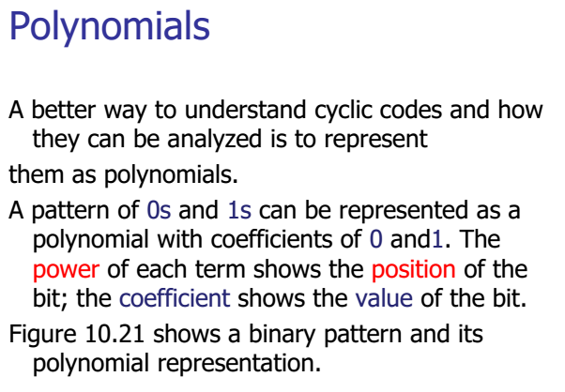

Slide 44
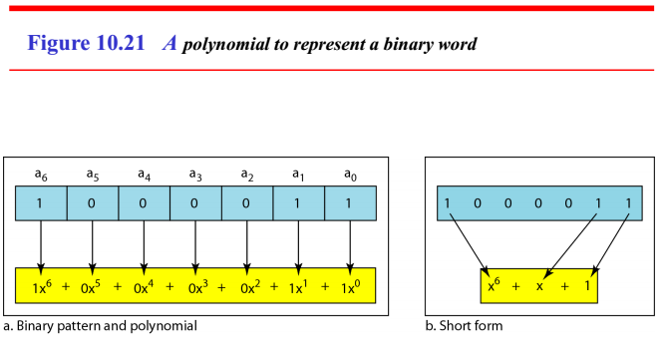

Slide 45
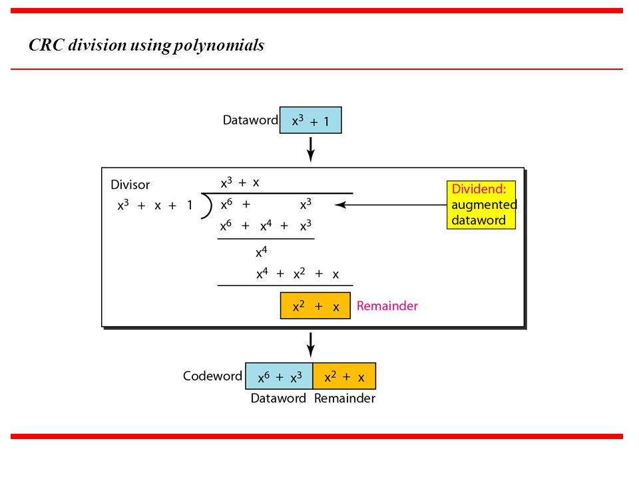
x³+x

Slide 46
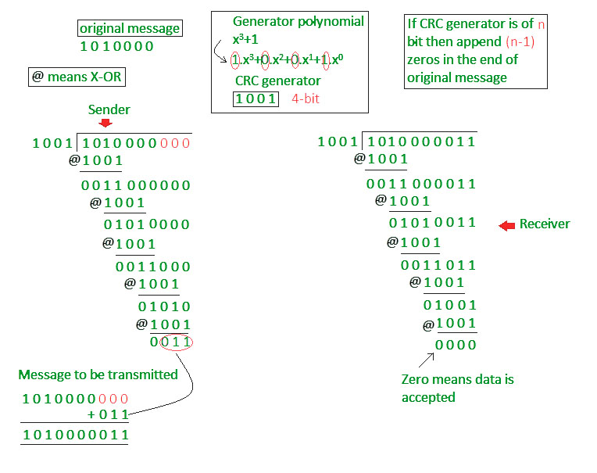

Slide 47
Checksum
In checksum error detection scheme, the data is divided into k segments each of m bits.
In the sender’s end the segments are added using 1’s complement arithmetic to get the sum. The sum is complemented to get the checksum.
The checksum segment is sent along with the data segments.
At the receiver’s end, all received segments are added using 1’s complement arithmetic to get the sum. The sum is complemented.
If the result is zero, the received data is accepted; otherwise discarded.

Slide 48
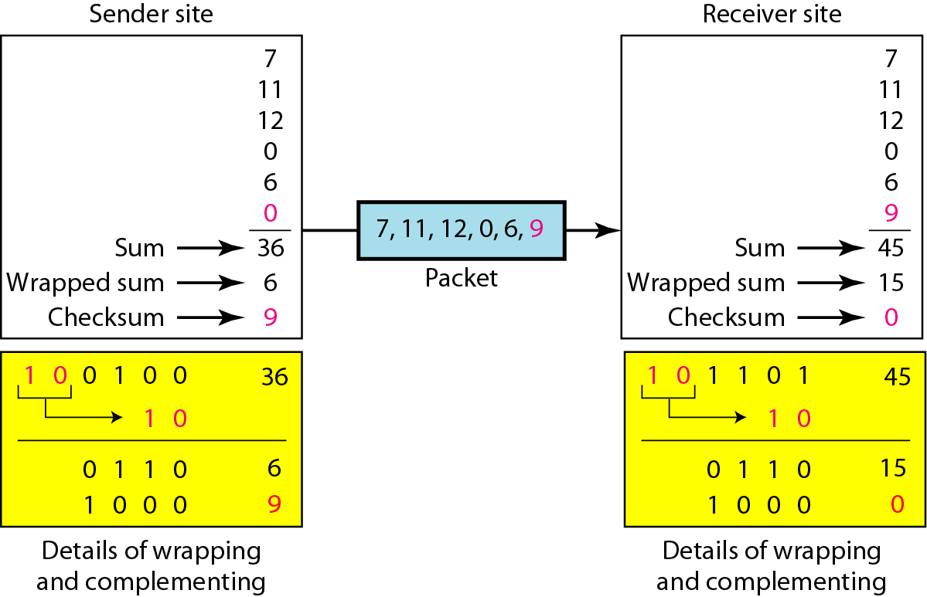
Checksum
1 1 1 1
0 0 0 0
1

Slide 49
